Slide 1

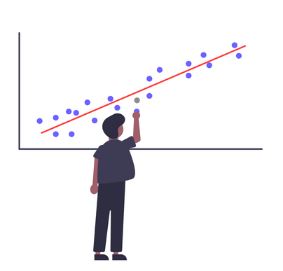
Linear Regression: A practical perspective
By:
Shagun Kala
Krit Poshakrishna

Slide 2
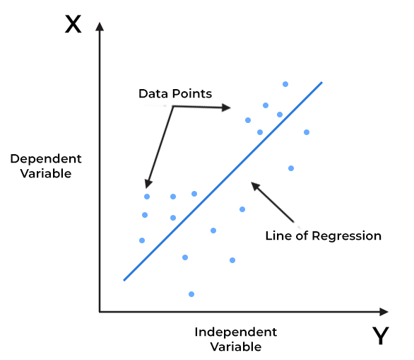
Understanding Linear Regression
Linear regression is a statistical method used to model the relationship between a dependent variable (Y) and one or more independent variables (X).
It aims to find the best-fitting line (or hyperplane in multiple dimensions) that minimizes the sum of squared differences between observed and predicted values.
It's widely used for prediction and understanding the influence of variables.
1/15

Slide 3
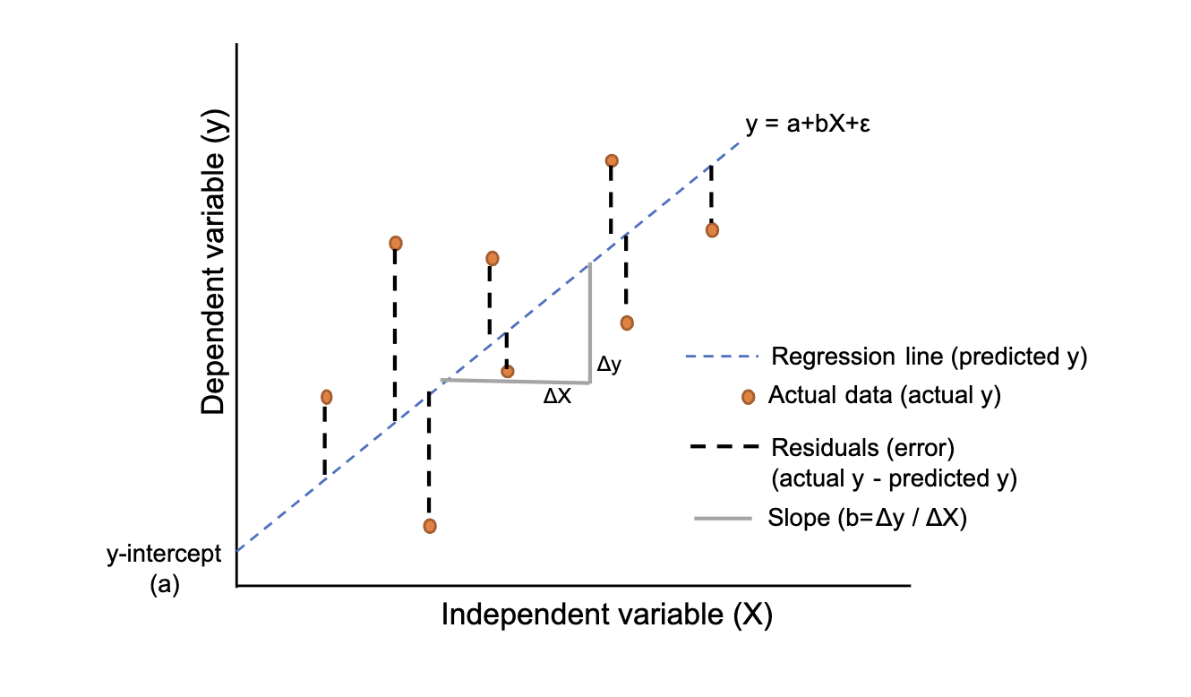

Core Concepts of Linear Regression
Dependent Variable (Y): The variable we are trying to predict or explain.
Independent Variable(s) (X): The variable(s) used to make predictions.
Regression Line: The line that best fits the data points, representing the relationship between X and Y.
Residuals: The differences between observed and predicted values.
2/15

Slide 4
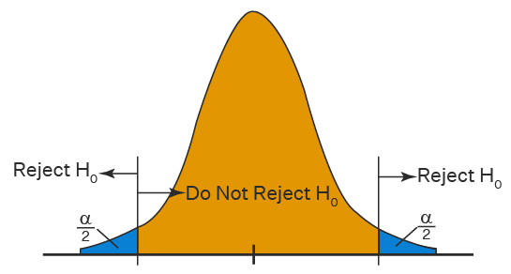
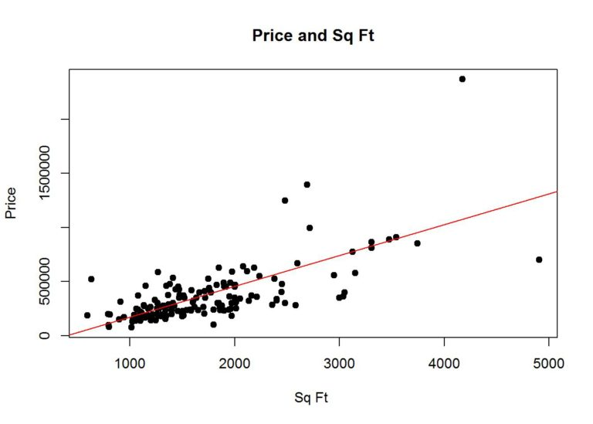
Applications
Impact Assessment (Hypothesis Testing)
Helps determine if there's a meaningful connection between the independent and dependent variables.
Example: Analyzing the impact of marketing spending on product sales to identify which factors significantly contribute to revenue.
Prediction and Forecasting
Linear regression is a powerful tool for making predictions based on historical data. It provides a mathematical model that can be used to estimate future values of the dependent variable.
Example: Predicting future housing prices based on features like square footage, number of bedrooms, and location.
3/15

Slide 5
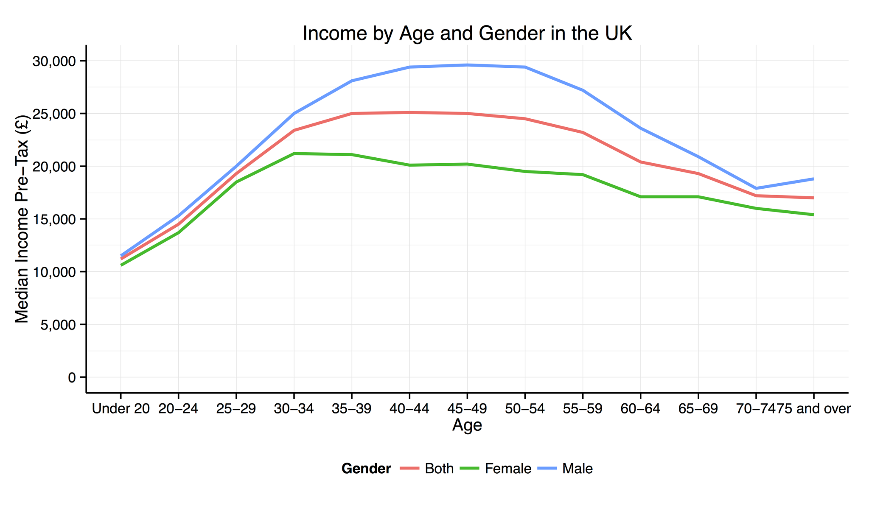
Assumptions
Linearity: The relationship between the independent and dependent variables is linear.
Independence: Observations in the dataset are independent of each other.
Homoscedasticity: The residuals (errors) have constant variance at every level of the independent variable(s).
Normality: The residuals of the model are normally distributed.
Drawbacks
May oversimplify real-world complex relationships.
Can be heavily influenced by outliers.
Assumes a constant slope across independent variables.
4/15

Slide 6
Enough of Theory!
Let’s switch to practicality!
5/15

Slide 7
How to train linear regression on real world data as a data scientist?
6/15

Slide 8
Model Diagnosis and Selection Steps
Multicollinearity check
Fit Initial LR Model
Check Influential Points
Heteroscedasticity Check
Heatmap
VIF
Drop correlated predictors to fix.
External Studentized Residuals
Cook’s distance
Check their impact on performance.
BP Test
Use box-cox to fix.
Re-train the LR Model on significant features
Check feature significance
Fit 2nd LR Model
Normality Check
T-test
ANOVA test
JB Test
QQ Plot
Use box-cox to fix.
Run forward feature selection
Select the best model having highest R2, lowest Mellow Cp and AIC/BIC.
Model diagnosis
Model (feature) selection
7/15

Slide 9
Common Linear Regression Pitfall
8/15

Slide 10
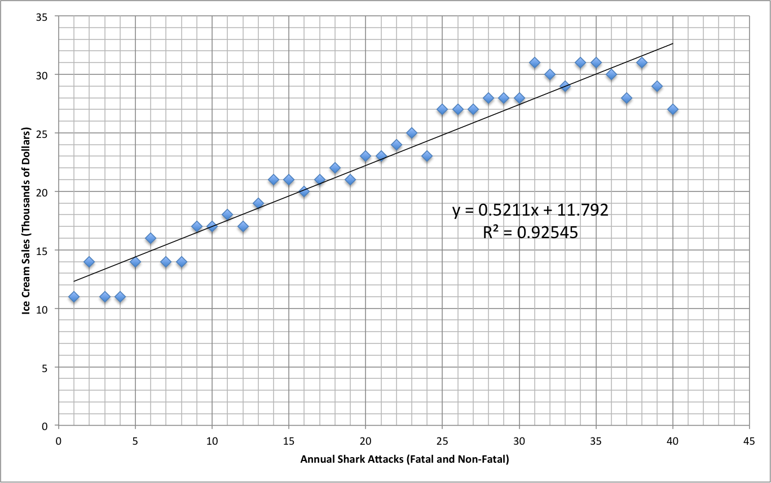
Correlation VS Causation
Ice Cream sales vs Shark attacks
Rise in Ice Cream sales causes rise in shark attacks!
So, stop eating ice creams.
9/15
Reference: https://www.varsitytutors.com/common_core_high_school__statistics_and_probability-help/correlation-vs-causation-ccss-math-content-hss-id-c-9

Slide 11
Correlation VS Causation
Ice Cream sales vs Shark attacks
Rise in Ice Cream sales causes rise in shark attacks!
So, stop eating ice-creams.
9/15
Reference: https://www.varsitytutors.com/common_core_high_school__statistics_and_probability-help/correlation-vs-causation-ccss-math-content-hss-id-c-9

Slide 12


Correlation VS Causation
Ice Cream sales vs Shark attacks
Correlation
9/15
Reference: https://www.varsitytutors.com/common_core_high_school__statistics_and_probability-help/correlation-vs-causation-ccss-math-content-hss-id-c-9

Slide 13

Correlation does not imply causation
Ice Cream sales vs Shark attacks
Causation
Causation
Correlation
While correlation measures the strength and direction of a linear relationship between two variables, causation determines whether changes in one variable are responsible for changes in another.
9/15
Reference: https://www.varsitytutors.com/common_core_high_school__statistics_and_probability-help/correlation-vs-causation-ccss-math-content-hss-id-c-9

Slide 14
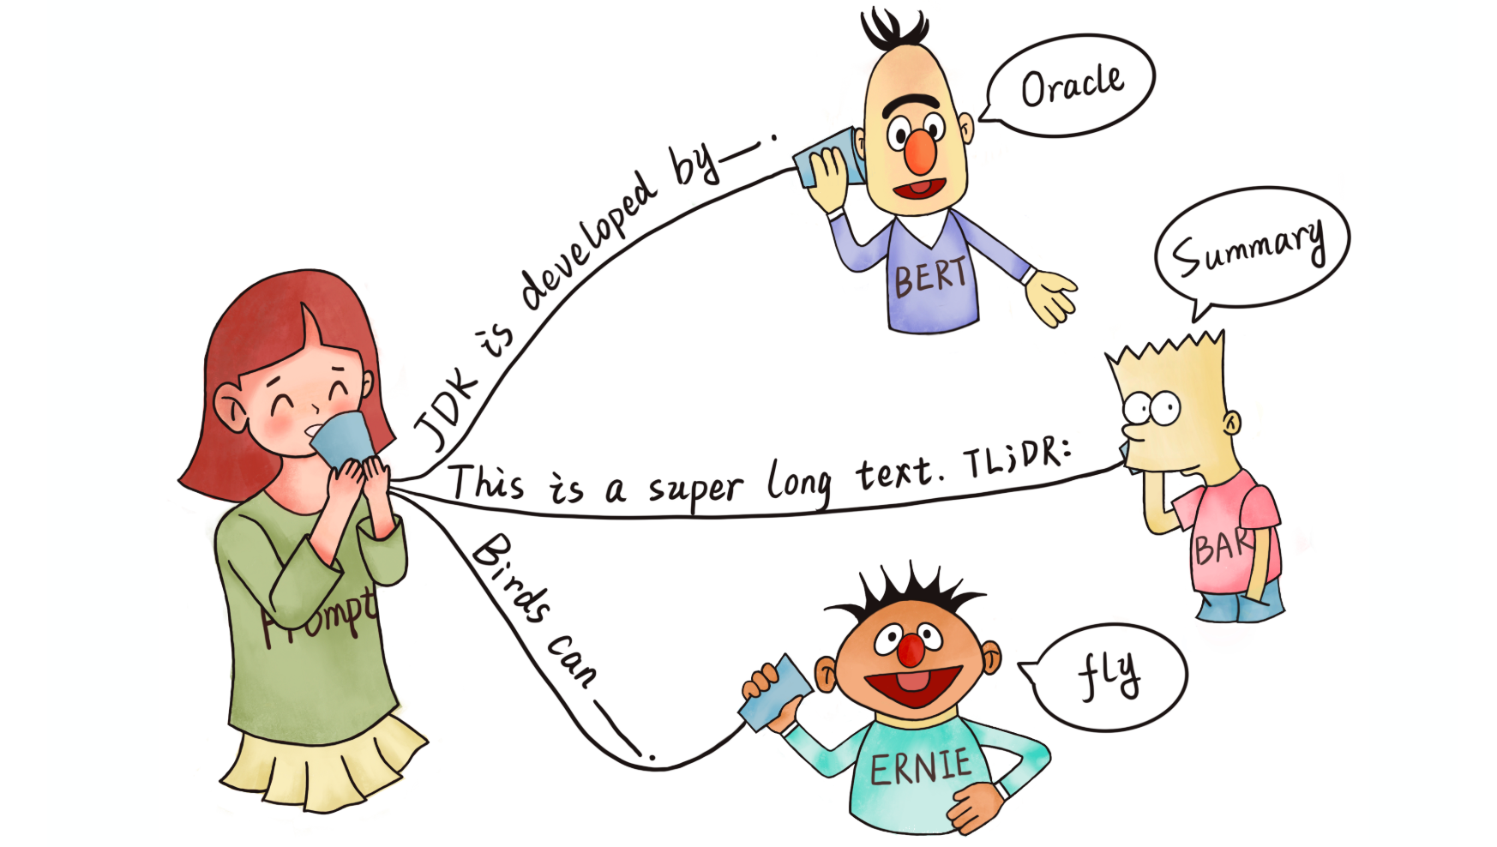
Who cares?
Linear Regression is boring and weak.
Its 2023! Neural Network rules!!!
10/15

Slide 15
Get ready to have your mind blown!
11/15

Slide 16
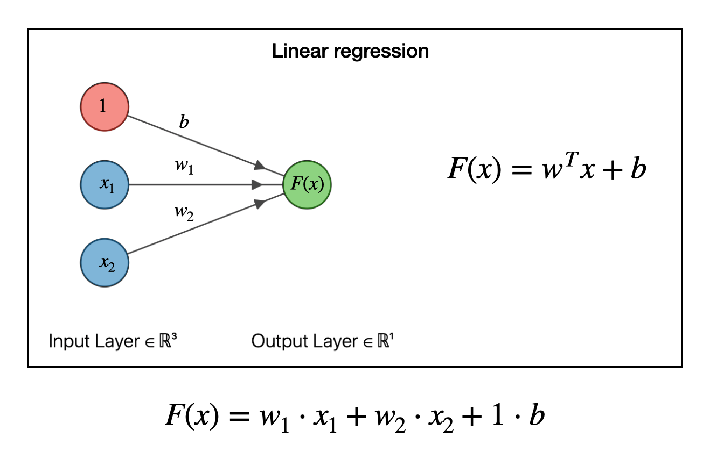
Linear Regression impact in state-of-the-art
12/15
Reference: https://joshuagoings.com/2020/05/05/neural-network/

Slide 17
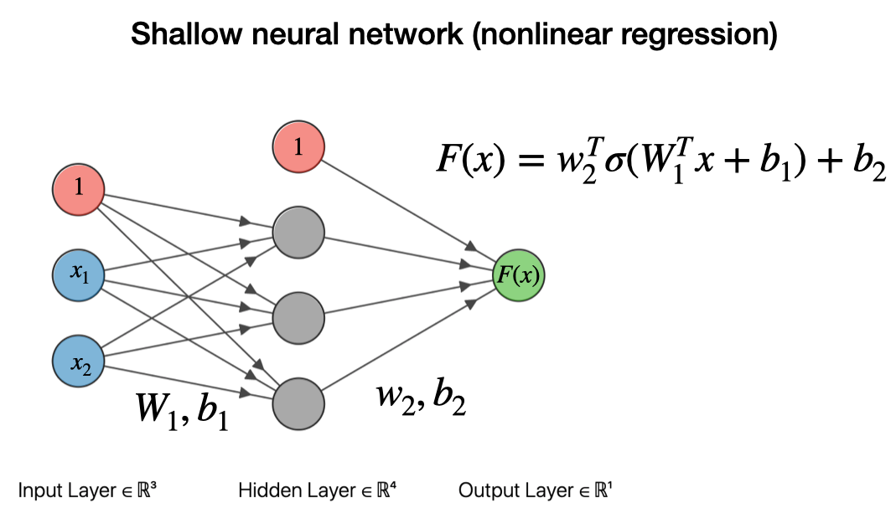
Linear Regression impact in state-of-the-art
13/15
Reference: https://joshuagoings.com/2020/05/05/neural-network/

Slide 18
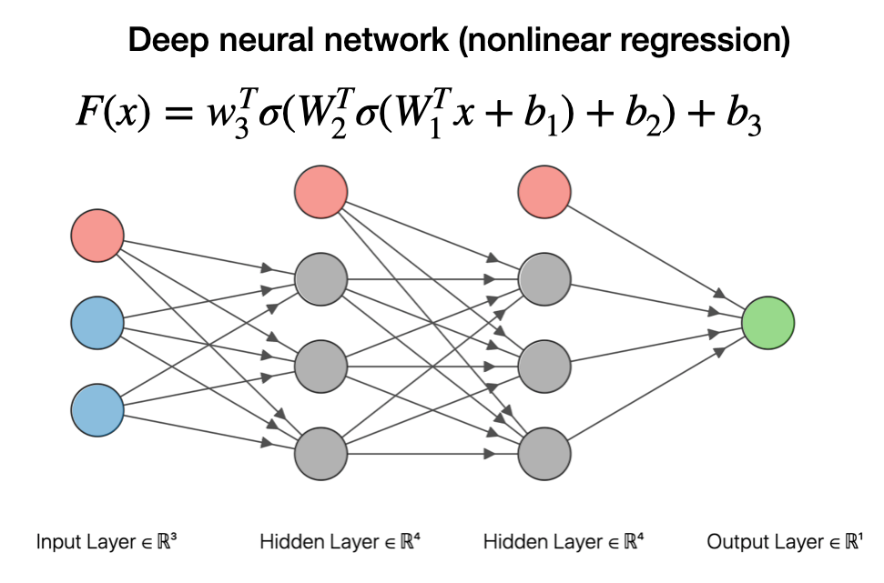
Linear Regression impact in state-of-the-art
14/15
Reference: https://joshuagoings.com/2020/05/05/neural-network/

Slide 19
Curious Minds?
15/15

Slide 20
Appendix

Slide 21
Case Study: Failing Assumptions
Predicting Income with Age
Linearity Assumption: Relationship between age and income isn't always linear.
Independence of Observations: Independence may fail with repeated observations from the same individual.
Homoscedasticity: Income variability might not be consistent across ages.
Normality of Residuals: Income data can be right-skewed. This might break the normality assumption.
No Multicollinearity: Age could correlate with variables like education or experience, leading to multicollinearity issues.
5/16
Reference: https://en.m.wikipedia.org/wiki/File:UK_Income_by_Age_and_Gender.png
Notes:
Linearity Assumption:
Failure: In reality, the relationship between age and income may not be strictly linear. For example, income might increase steadily with age up to a certain point, and then plateau or even decrease in retirement.
Independence of Observations:
Failure: In this case, independence may not hold if the data includes multiple observations from the same individual over time. For instance, a person's income at age 30 may be correlated with their income at age 40.
Homoscedasticity (Equal Variance):
Failure: The variability in income may not be consistent across different age groups. For example, younger individuals may have more variation in income due to career changes or job-hopping.
Normality of Residuals:
Failure: Income data can often be right-skewed, meaning there may be a higher concentration of lower income individuals and a long tail of higher income earners. This violates the normality assumption.
No Multicollinearity:
Failure: Age may be correlated with other variables, such as education level or years of experience, which could lead to multicollinearity issues.

Slide 22






Applications where the linear regression model might be applied
In which part does linear regression play role?
Notes:
-Duolingo, a language learning app, might employ linear regression to determine how well a user is progressing. By analyzing the speed of completion, the number of mistakes, and the type of exercises a user interacts with, it can predict when a user is ready to move to the next level or needs more practice on a particular topic.
-Plantnet, Users can identify plants by taking pictures. Linear regression could be used in combination with other models to correlate certain plant characteristics or patterns with specific species based on user submissions.
-Strava, a popular app for tracking running and cycling activities, may use linear regression to predict future performance based on historical data. For instance, based on previous race times or workouts, it could predict your completion time for an upcoming marathon.
-WaterMinder, Helps users track daily water intake. It might use linear regression to predict when you're likely to feel dehydrated based on your past drinking habits and remind you accordingly.

Slide 23
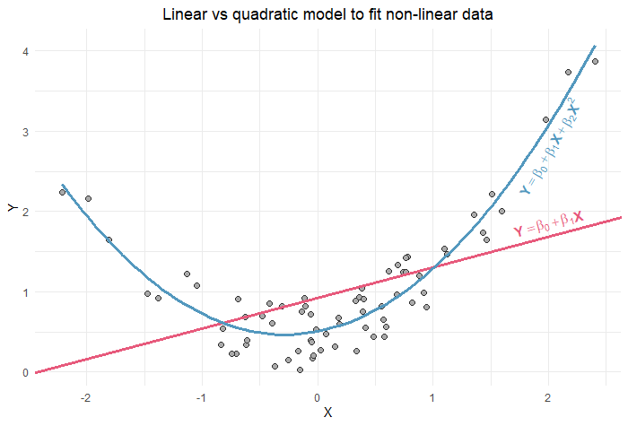
When Linear Regression fails?
Ever tried putting socks on a rooster? -That's how this model feels!

Slide 24
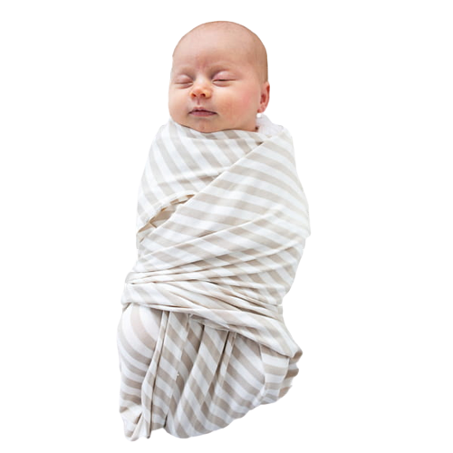
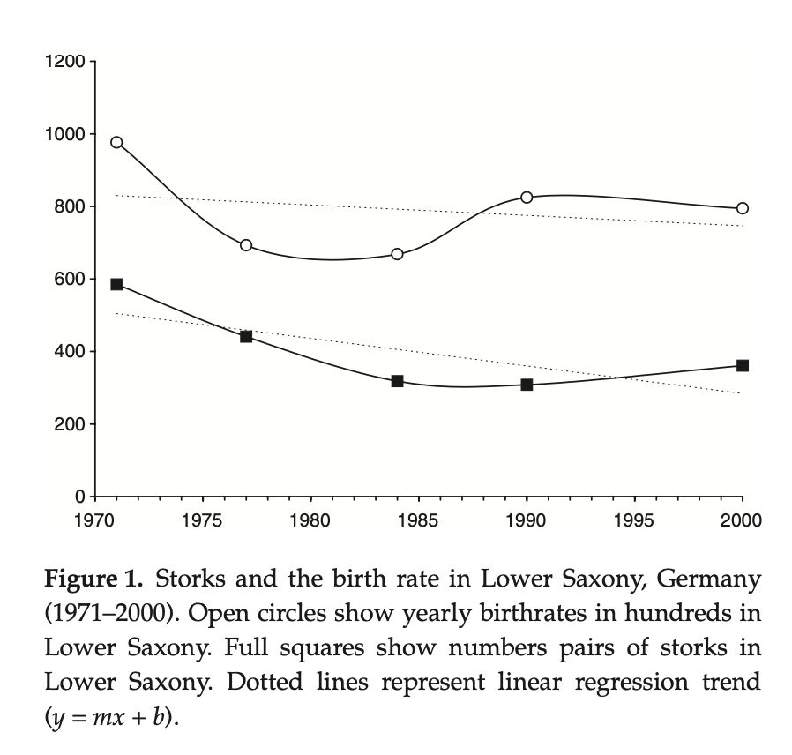
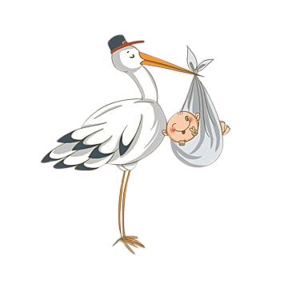
Case Study
Did you know?
Have correlation?
stork populations
human birth rates in European countries
Notes:
Did you know? A famous case of 'model mismatch' was when researchers tried to correlate stork populations with human birth rates in European countries. Linear models showed a strong relationship! Of course, storks don't deliver babies, but the models didn't know that. Always check if your model fits the story! I grab it fromhttps://www.researchgate.net/figure/Storks-and-the-birth-rate-in-Lower-Saxony-Germany-1971-2000-Open-circles-show-yearly_fig2_8906298

